Slide 1

Project:
Cafeteria Management
System
Group:
T-RISE

Slide 2
In this presentation
~ Software Development Methodology
~ Project Management Tools
~ Client Meetings
~ Technologies
~ Unit Testing

Slide 3
Software Development Methodology
~ Agile Method: Scrum
1) Identify and prioritize requirements
2) Identify top priorities (for sprints)
3) Identify the sprint development
activities (Milestones on GitHub)

Slide 4
Software Development Methodology
~ Sprint Iterations
1) Weekly meetings
~ Planning and discussing issues related to current sprint

Slide 5
Software Development Methodology
~ Sprint Iterations
1) Log issues to do with sprint
2) Implement planning
3) Test planning
4) Update the documentation
~ Such as user manual, testing documentation
5) Consult with client after each sprint

Slide 6
Client Meetings
~ Present Progress and demo functionality
~ Discuss alterations
~ Receive feedback
~ Create necessary issues for alterations
Meeting Dates:

Slide 7
Project Management Tools
~ Waffle.io – Scrum Board, linked with all git
issues and milestones
~ Burndown.io – Burndown charts linked with
issues on git

Slide 8
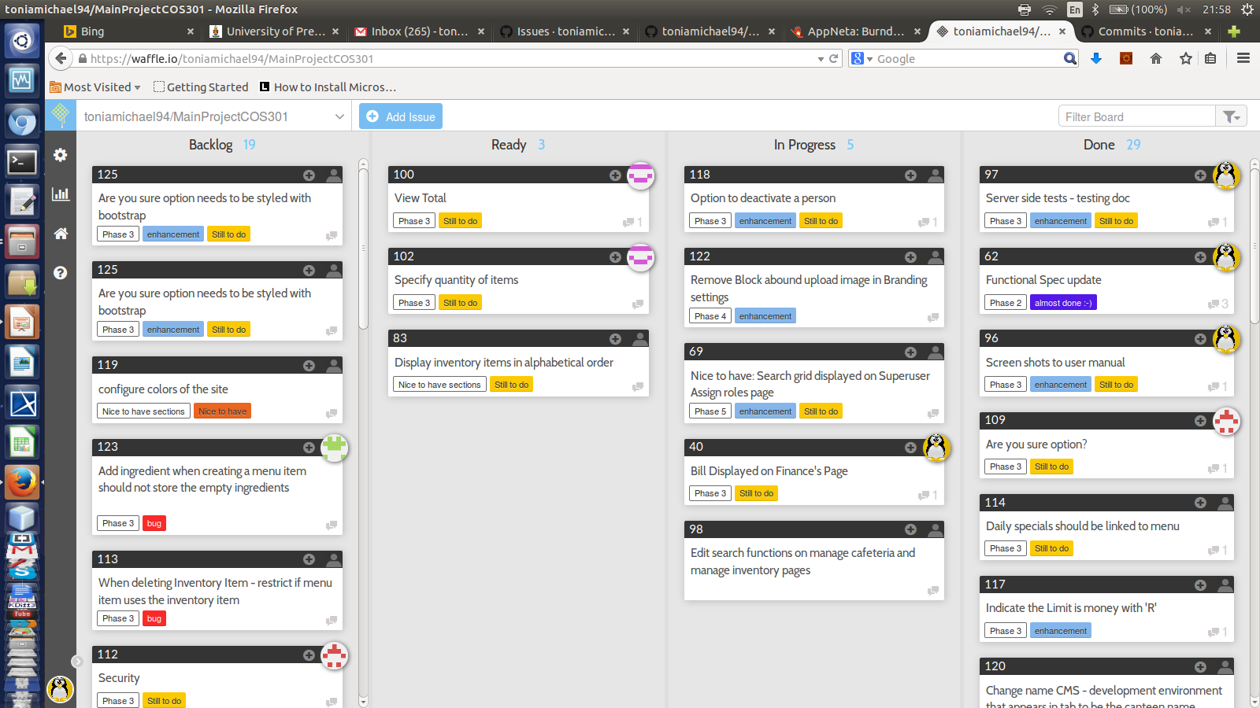
Scrum Board
This can be viewed on project README on GitHub repo

Slide 9
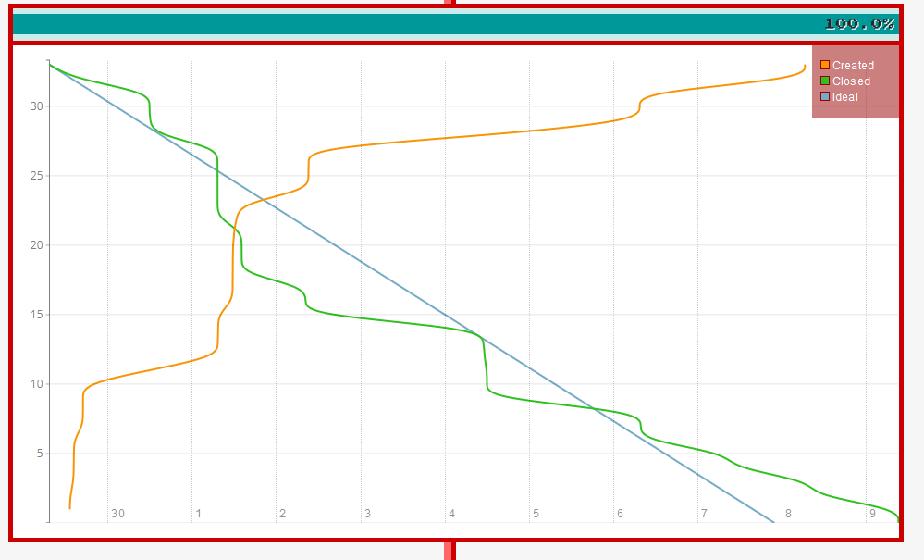
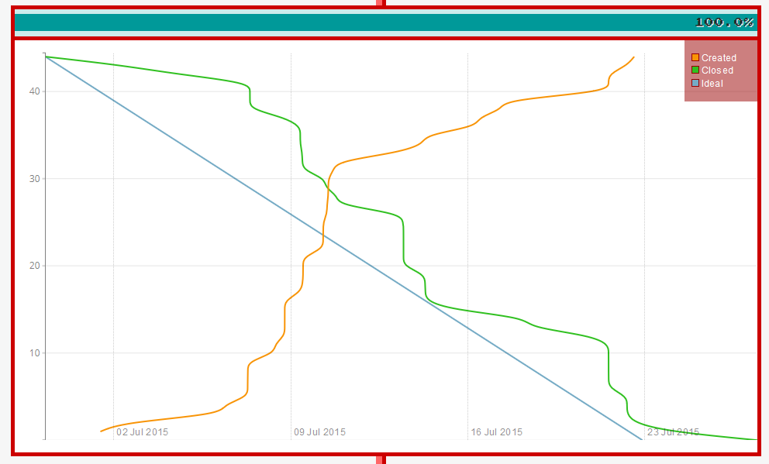
Burndown Charts
Phase 1 – completed:
Phase 2 – completed:
This can be viewed on project README on GitHub repo

Slide 10
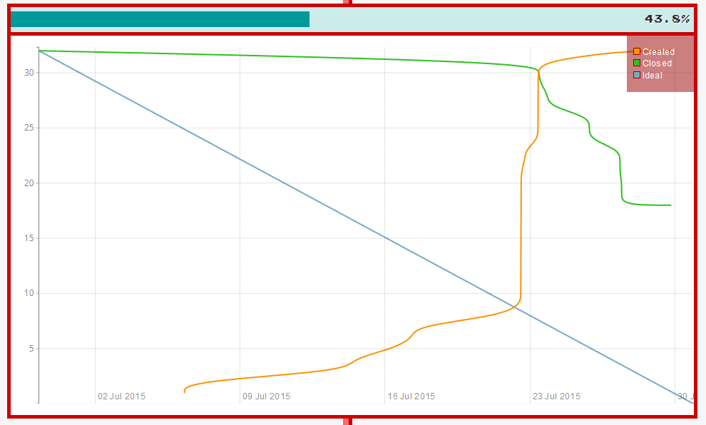
Burndown Charts
Current phase :

Slide 11
Technologies
~ MeanJS - JavaScript solution that helps you
build fast, robust, and maintainable production web applications using
MongoDB, Express, AngularJS, and Node.js.
~ Build Tools - Grunt, yeoman, npm and bower
~ Styling – Bootstrap

Slide 12
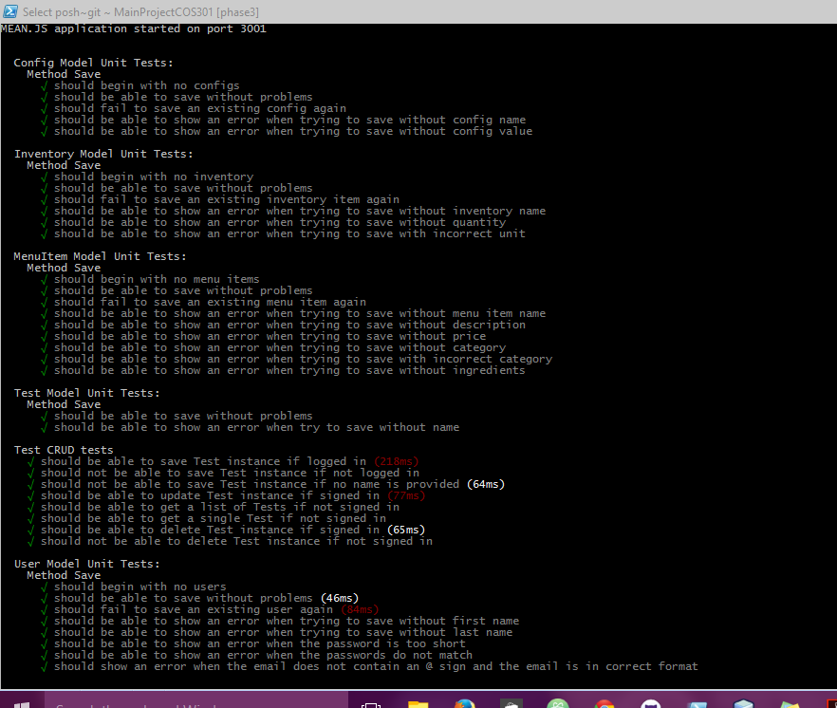
Unit Testing
~ Phantom JS and Karma (Server side testing)
~ Mocha (Client side testing )

Slide 13
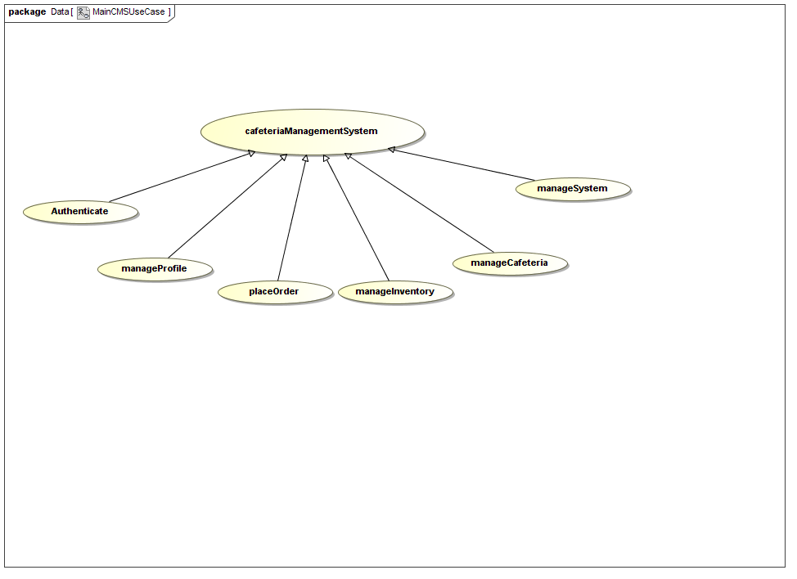
High Level Use Case Diagram:
~ Demonstation of the system (Agile) for use cases:
- Profile
- PlaceOrder
- ManageInventory
- ManageMenu
- Authentication
- Manage System

Slide 14
Documentation:
~ Functional Specification
~ Architecture Specification
~ Testing documentation
~ User Manual
~ Design Documentation

